Slide 1
Principles of management
BY- CHINTAN PRAJAPATI

Slide 2
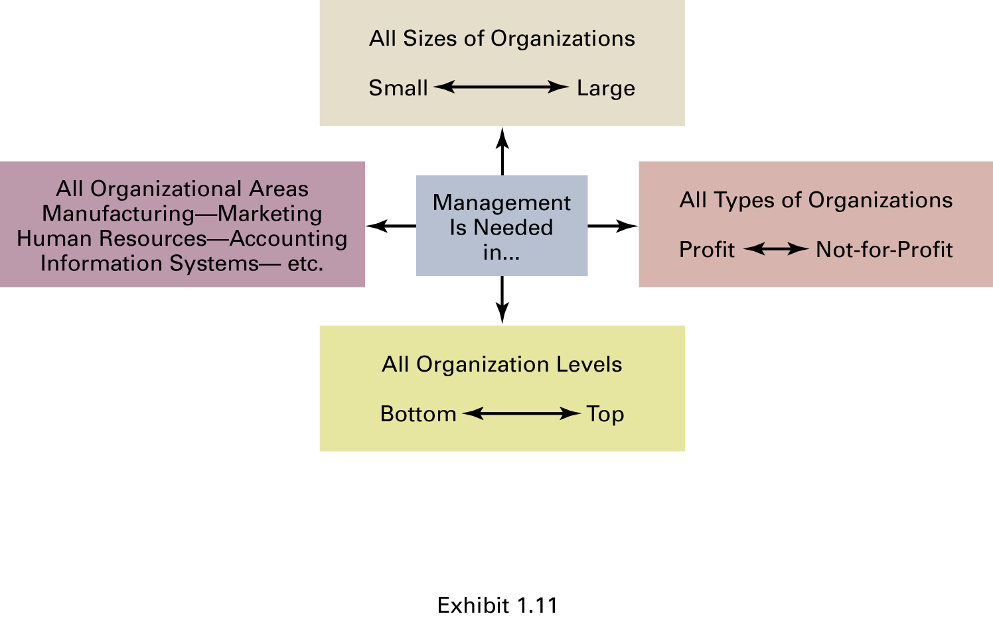
WHY TO STYDY MANAGEMENT ???

Slide 3
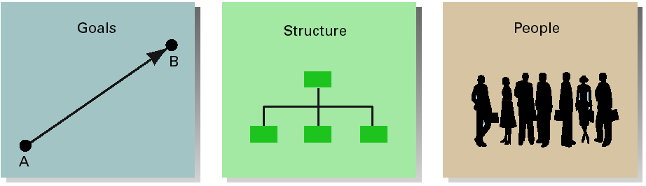
CHARACTERISTICS OF ORGANIZATION

Slide 4
CONCEPT OF MANAGEMENT
Management as a Discipline.
Management as a Group Of People.
Management as a Process.

Slide 5
DEFINITION OF MANAGEMENT
According to Frederick Taylor :- “Management is an art of knowing what you want to do and then just seeing that it is done in the best and cheapest way”.
According to Koontz :- “It is an art of getting things done through and with people in formally organized groups”.

Slide 6
IMPORTANCE OF MANAGEMENT
Effective utilization of resources
Development of resources
To incorporate innovation
Integrating various interest groups
Stability in the society

Slide 7
FEATURES OF MANAGEMENT
Organized Activities
Existence of objective
Relationship among resources
Working with and through people
Decision making

Slide 8
WHO IS A MANAGER ???
Manger get the work done from others.
Managers are the coordinators and directors in the organization.
People responsible for directing the efforts aimed at helping organization to achieve their goals.
Aim of managers is to create surplus.
Some examples we know as a manager:-
Steve jobs at apple computers
Bill ford at ford motor company
Bill gates at Microsoft

Slide 9
FUNCTIONS OF MANAGEMENT
PLANNING
ORGANIZING
STAFFING
DIRECTING
FEEDBACK
CONTROLLING

Slide 10
CONT…
Planning
The process of establishing goals and a suitable course of action for achieving those goals.
The continuous determination of future course of action.
Organizing
The process of engaging two or more people in working together in a structured way to achieve a specific goal or set of goals.

Slide 11
CONT…
Staffing
Managing the various positions created by the organizing process.
Involves filling and keeping filled the position in the organization structure.
Directing
Includes communicating, motivating and leading the task related activities of group members or an entire organization.
Controlling
Involves identification of actual results, comparison of actual results with expected results as set by planning process.
The process of ensuring that actual activities conform to planned activities.

Slide 12
MANAGEMENT SCIENCE OR ART
“Science”
It is a specialized knowledge based on certain principles . Such principles are derived with the help of observation , experiments , and experience.
Accepted and accumulated with reference to understanding of general truth.
“Art”
Use of skills for getting desired result.
Skills can be developed with the help of experience and training.
Involves practice and creativity.

Slide 13
MANAGEMENT SCIENCE OR ART
It is said that where the science of management stops, the art of management begins. Thus, Science teaches principles, art teaches how to implement them.

Slide 14
LEVELS OF MANAGEMENT
Top level Management.
CEO, President, Vice-President
Middle level Management
Assistant Manager, Functional Head
Lower Level Management
Technical Supervisor, Foreman, Clerical supervisor, etc.

Slide 15
MANAGEMENT LEVEL & SKILLS
Top Management
Conceptual Skill
Middle Management
Human Relations Skill
Supervisory Level
Technical Skill

Slide 16
MANAGERIAL CONCERNS
Efficiency
“Doing things right”
Getting the most output for the least inputs
Ability to use resources wisely and in a cost-effective manner.
Effectiveness
“Doing the right things”
Attaining organizational goals

Slide 17
MANAGERIAL ROLES
INTERPERSONAL ROLES
Figurehead role
Leader role
Liaison role
INFORMATIONAL ROLES
Recipient role
Disseminator role
Spokes person
DECISION ROLES
Entrepreneurial role
Disturbance-handler role
Resource allocator role
Negotiator role

Slide 18
Management principles
DIVISION OF WORK
Work should be divided among individuals and groups to ensure that effort and attention are focused on special portions of the task.
AUTHORITY
The concepts of Authority and responsibility are closely related.
DISCIPLINE
A successful organization requires the common effort of workers. Penalties should be applied judiciously to encourage this common effort.
UNITY OF COMMAND
Workers should receive orders from only one manager.
UNITY OF DIRECTION
The entire organization should be moving towards a common objective in a common direction.

Slide 19
Cont…
SUBORDINATION OF INDIVIDUAL INTERESTS TO THE GENERAL INTERESTS
The interests of one person should not take priority over the interests of the organization as a whole.
REMUNERATION
cost of living, supply of qualified personnel, success of the business, should be considered in determining a worker’s rate of pay.
CENTRALIZATION
lowering the importance of the subordinate role.

Slide 20
Cont…
SCALAR CHAIN
Managers in hierarchies are part of a chain like authority scale.
ORDER
For the sake of efficiency and coordination, all materials and people related to a specific kind of work should be treated as equally as possible.
EQUITY
All employees should be treated as equally as possible.
STABILITY OF TENURE OF PERSONNEL
Retaining productive employees should always be a high priority of management.

Slide 21
Cont…
INITIATIVE
Management should take steps to encourage worker initiative
ESPIRIT DE CORPS
Management should encourage harmony and general good feelings among employees.

Slide 22
MANAGEMENT AND ADMINISTRATION
Management sets the target while Administration fulfills target.
Management Plans for entire organization while Administration implement plan
Management occupies superior position while Administration occupies secondary position.
Management is concerned with long term problem while administration is concerned with short term day to day problem.
Management is not substitute to Administration But they are complementary to each other.

Slide 23
TYPES OF BUSINESS ORGANISATION
Sole Proprietorship
A business owned and operated by one person.
The owner is responsible for all operations of the business and assumes all the risk.
Partnership
A form of business organization in which two or more people own and operate the business together
Corporation
a)Private Ltd.
b)Public Ltd.
Cooperative
Businesses owned and operated by a group of people with a strong common interest
Start-up costs are shared among the members of the co-operative

Slide 24
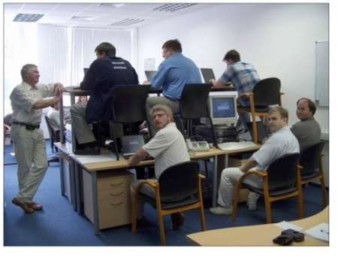
Thank you…

